Slide 1


SPEECH EMOTION RECOGNITION USING MLP CLASSIFIER
2021
A Project Report on
SPEECH EMOTION RECOGNITION USING MLP CLASSIFIER
Submitted in Partial Fulfilment of the Requirement
for the IV Semester MCA Academic Minor Project – I
18MCA46
MASTER OF COMPUTER APPLICATIONS
By
USN | STUDENT NAME
1RV19MCA21 | CHAITRA B V
1RV19MCA35 | JANVI NAGESH NAIK
Under the Guidance of
Dr S Anupama Kumar Associate Professor Department of MCA
RV College of Engineering®
Department of Master of Computer Applications RV College of Engineering®,
Accredited by National Board of Accreditation, Mysuru Road
RV Vidyanikethan Post, Bengaluru – 560059
June -2021
Department of MCA, RVCE
vii

Slide 2
SPEECH EMOTION RECOGNITION USING MLP CLASSIFIER
2021
DEPARTMENT OF MASTER OF COMPUTER APPLICATIONS
CERTIFICATE
This is to certify that the project entitled “SPEECH EMOTION RECOGNITION USING MLP CLASSIFIER” submitted in partial fulfillment of Minor Project-I (18MCA46) of IV Semester MCA is a result of the bonafide work carried out by CHAITRA B V-1RV19MCA21 and JANVI NAGESH NAIK -1RV19MCA35 during the Academic year 2020-21.
Dr S Anupama Kumar | Dr. Andhe Dharani
Associate Professor | Professor and Director
Department of MCA, | Department of MCA,
RV College of Engineering® | RV College of Engineering®
Department of MCA, RVCE
vii

Slide 3
SPEECH EMOTION RECOGNITION USING MLP CLASSIFIER
2021
UNDERTAKING BY THE STUDENT
We, CHAITRA B V-1RV19MCA21 and JANVI NAGESH NAIK-1RV19MCA35,
hereby declare that the Minor project-I SPEECH EMOTION RECOGNISITION USING MLP CLASSIFIER is carried out and completed successfully by us and is our original work.
SIGNATURE
(CHAITRA B V)
(JANVI NAGESH NAIK)
Department of MCA, RVCE
vii

Slide 4
SPEECH EMOTION RECOGNITION USING MLP CLASSIFIER
2021
Acknowledgement
We would like to thank all those who are involved in this endeavour, for their kind cooperation for its successful completion. At the outset, we wish to express our sincere gratitude to all those people who have helped us to complete this project in an efficient manner.
We offer our special thanks to our Project guide Dr S Anupama Kumar Associate Professor, Department of MCA, RVCE without whose help and support this project would not have been this success.
Most of all and more than ever, we would like to thank our family members for their warmness, support, encouragement, kindness and patience. We are really thankful to all our friends who always advised and motivated us throughout the course.
Department of MCA, RVCE
vii

Slide 5
SPEECH EMOTION RECOGNITION USING MLP CLASSIFIER
2021
Abstract
Speech Emotion Recognition, abbreviated as SER, is the act of attempting to recognize human emotion and affective states from speech. This is capitalizing on the fact that voice often reflects underlying emotion through tone and pitch. Speech Emotion Recognition can be used by multiple industries to offer different services like marketing company suggesting you to buy products based on your emotions, automotive industry can detect the persons emotions and adjust the speed of autonomous cars as required to avoid any collisions etc.
Speech Emotion Recognition involves speech feature extraction and voice activity detection. The process involves Using MLP Classifier for analysing speech features to include tone, energy, pitch, format frequency, etc. and identifying emotions through changes in these. Nowadays personalization is something that is needed in all the things experienced every day. This Project will be implemented in python using resources such as Anaconda for Python 3.6.5 and Spyder. The library such as librosa, soundfile, and sklearn (among others) to build a model using an MLP Classifier. This will recognize emotion from sound files. Data will be loaded and features will be extracted from it, then dataset will be divided into training and testing sets. Then, it will be initialized by MLP Classifier and model will be trained. Finally, the accuracy of the model will be calculated.
Detection and Analysis of Emotion from Speech Signals will improvise man-machine interface. This project builds a model that could detect emotions from the speech. It can also be used to monitor the psycho physiological state of a person in lie detectors. In recent time, Speech Emotion Recognition also finds its applications in medicine and forensics
Department of MCA, RVCE
vii

Slide 6
SPEECH EMOTION RECOGNITION USING MLP CLASSIFIER
2021
Table Of Contents
Contents | Page No
College Certificate | i
Company Certificate | ii
Undertaking by student | iii
Acknowledgement | iv
Abstract | v
Table of Contents | vi
List of Tables | vii
List of Figures | vii
Chapter 1: Introduction | 1
1.1 Project Description | 1
Chapter 2: Literature Review | 2
2.1 Literature Survey | 2
2.2 Existing and Proposed System | 6
2.3 Tools and Technologies used | 8
2.4 Hardware and Software Requirements | 9
Chapter 3: Software Requirement Specifications | 10
3.1 Introduction | 10
3.2 General Description | 10
3.3 Functional Requirement | 11
3.4 Non-Functional Requirements | 12
Chapter 4: System Design | 13
4.1 System Perspective /Architectural Design | 13
4.2 Context Diagram | 13
Chapter 5: Detailed Design | 14
5.1 System Design | 14
5.2 Detailed design | 15
Department of MCA, RVCE
vii

Slide 7
SPEECH EMOTION RECOGNITION USING MLP CLASSIFIER
2021
Chapter 6 Implementation | 17
Code Snippets / PDL Implementation | 17 29
Chapter 7: Software Testing | 33
Test cases Testing and Validations | 33 34
Chapter 8: Conclusion | 39
Chapter 9: Future Enhancements | 40
Bibliography | 41
LIST OF FIGURES
Figure No | Figure Label | Page No
1.1 | Block Diagram | 13
2.1 | Context Diagram | 13
3.1 | Data Flow Diagram | 14
4.1 | Class Diagram | 15
4.1 | Sequence Diagram | 16
5.1 | Activity Diagram | 16
LIST OF TABLES
Table No | Table Label | Page No
1.1 | Literature Survey | 2
2.1 | Test Cases | 34
Department of MCA, RVCE
vii

Slide 8
SPEECH EMOTION RECOGNITION USING MLP CLASSIFIER
2021
Chapter 1: Introduction
1.1 Project Description:
Speech Emotion Recognition, abbreviated as SER, is the act of attempting to recognize human emotion and affective states from speech. This is capitalizing on the fact that voice often reflects underlying emotion through tone and pitch. This is also the phenomenon that animals like dogs and horses employ to be able to understand human emotion. SER is tough because emotions are subjective and annotating audio is challenging. In machine interaction with human being is yet challenging task that machine should be able to identify and react to human non-verbal communication such as emotions which makes the human computer interaction become more natural. In present research area automatic emotion recognition using speech is an essential task which paid close attention. Speech signal is a rich source of information and it is an attractive and efficient medium due to its numerous features of expressing approach & extracting emotions through speech is possible. In most of In this paper emotions is recognized through speech using spectral features such as Mel frequency spectrum co-efficient prosodic features like pitch , energy and were utilized & study is carried out using MLP classifiers which is used for detection of six basic emotional states of speaker’s like anger ,happiness, sadness, fear, disgust and neutral using RAVDESS dataset.

Slide 9
SPEECH EMOTION RECOGNITION USING MLP CLASSIFIER
2021
Chapter 2: Literature Review
2.1: Literature Survey
S No | Author and Paper title | Details of Publication | Summary of the Paper
1 | Deepak Bharti, A Hybrid Machine Learning Model for Emotion Recognition From Speech Signals | Proceedings of the International Conference on Smart Electronics and Communication (ICOSEC 2020) IEEE Xplore Part Number: CFP20V90-ART; ISBN: 978-1- 7281-5461-9 | The feature extraction method using Gammatone Frequency Cepstral Co-efficient (GFCC) Dataset used in this paper is RAVDESS data set It analyses how the classification and feature extraction performance in the recognition rate of emotions in speech (Sad, Happy, and Angry)
2 | Pavol Harár , Radim Burget and Malay Kishore Dutta, Speech Emotion Recognition with Deep Learning | 2017 4th International Conference on Signal Processing and Integrated Networks (SPIN) | SER is used to predict the emotional state of a person from a short voice recording split into 20 millisecond segments. This approach is context independent which means that all audio segments were classified independently.

Slide 10
SPEECH EMOTION RECOGNITION USING MLP CLASSIFIER
2021
3 | Girija Deshmukh, Apurva Gaonkar, Gauri Golwalkar, Sukanya Kulkarni, Speech based Emotion Recognition using Machine Learning | Proceedings of the Third International Conference on Computing Methodologies and Communication (ICCMC 2019) IEEE Xplore Part Number: CFP19K25-ART; ISBN: 978-1- 5386-7808-4 | In this paper, three emotions- anger, happiness, and sadness, were classified using three feature vectors. Pitch, Mel frequency cepstral coefficients, Short Term Energy were the three feature vectors extracted from audio signals. Open source North American English acted speech corpus and recorded natural speech corpus were used as input.
4 | Saikat Basu, Jaybrata Chakraborty , Arnab Bag and Md. Aftabuddin, A Review on Emotion Recognition using Speech | International Conference on Inventive Communication and Computational Technologies (ICICCT 2017) | The study reveals the fact that identification of emotion of a person is a task yet to have complete and general solution. Till now, most of the work has been done on the fixed size speech segment for classification of emotion, that means on the off line speech.
5 | Esther Ramdinmawii , Abhijit Mohanta and Vinay Kumar Mittal, Emotion Recognition from Speech Signal | Proc. of the 2017 IEEE Region 10 Conference (TENCON), Malaysia, November 5-8, 2017 | This paper is about analyzing speech for emotion states (Anger, Fear, Neutral, Happy) using speech signals. The analysis of these emotion states has been done using features, namely, instantaneous fundamental frequency using Zero Frequency Filtering, Formant frequencies (F1, F2, F3), signal energy, and dominant frequencies. The speech files are sampled at 16 kHz for F0 and signal energy, and at 10 kHz for Formant frequencies and dominant frequencies.

Slide 11
SPEECH EMOTION RECOGNITION USING MLP CLASSIFIER
2021
6 | W. Q. Zheng, J. S. Yu, Y. X. Zou, An Experimental Study of Speech Emotion Recognition Based on Deep Convolutional Neural Networks | 2015 International Conference on Affective Computing and Intelligent Interaction (ACII) | In this paper, a deep convolution neural networks-based approach has been developed to learn the effective features for speech emotion recognition from audio spectrogram data A speech emotion recognition algorithm termed as PCA-DCNNs-SER is proposed. Preliminary experiments have been conducted to evaluate the performance of PCA-DCNNs-SER on the IEMOCAP database.
7 | RUHUL AMIN KHALIL , EDWARD JONES Speech Emotion Recognition Using Deep Learning Techniques | Received July 25, 2019, accepted August 5, 2019, date of publication August 19, 2019, date of current version September 4, 2019 | This paper has provided a detailed review of the deep learning techniques for SER. Deep learning techniques such as DBM, RNN, DBN, CNN, and AE have been the subject of much research in recent years. These deep learning methods and their layer- wise architectures are briefly elaborated based on the classification of various natural emotion such as happiness, joy, sadness, neutral, surprise, boredom, disgust, fear, and anger.
8 | LILI GUO, LONGBIAO WANG, JIANWU DANG Exploration of Complementary Features for Speech Emotion Recognition Based on Kernel Extreme Learning Machine | Received May 10, 2019, accepted June 2, 2019, date of publication June 6, 2019, date of current version June 24, 2019 | This paper focused on improving speech emotion recognition by using complementary features. To utilize the potential advantages of two types of features (i.e., the spectrogram-based statistical features and auditory-based empirical features),a dynamic fusion framework to extract the complementary features based on spectrograms and the auditory-based features

Slide 12
SPEECH EMOTION RECOGNITION USING MLP CLASSIFIER
2021
9 | MUSTAQEEM , MUHAMMAD SAJJAD , AND SOONIL KWON Clustering-Based Speech Emotion Recognition by Incorporating Learned Features and Deep BiLSTM | Mustaqeem et al.: Clustering-Based SER by Incorporating Learned Features and IEEE Access, vol. 6, pp. 52227– 52237, 2018. | The existing CNNs system of SER has too many challenges such as improvement in accuracy and reduce the computational complexity of the whole model. Due to these limitations, we planned a novel approach for SER to improve the recognition accuracy and reduce the overall model cost computation and processing time.
10 | A Pramod Reddy and V. Vijayarajan2, Extraction of Emotions from Speech | International Journal of Applied Engineering Research ISSN 0973-4562 Volume 12, Number 16 (2017) pp. 5760-5767 | This paper presents Most common emotions searched and extracted are Happiness’, Sadness, Disgust, Neutral along with other features such as joy, Borden, fear and surprise. The extraction rate depends on the classifier used.

Slide 13
SPEECH EMOTION RECOGNITION USING MLP CLASSIFIER
2021
2.1 Existing and Proposed System
Existing System:
Speech Emotion Recognition is a subject under research. Speech emotion recognition abbreviated as SER. It creates a natural Human Computer interaction. There are various kinds of methods used to identify the emotion from the speech, such as using support vector machine (SVM), Recurrent Neural Network, K-nearest neighbour, Hidden Markov Model (HMM).
Support Vector Machine (SVM): Support Vector Machine approach computes the audio parameters to identify the emotion and has high accuracy in predicting the emotion from the speech. But this approach can only classify the dataset into 2 classes only. That means we can only identify among the 2 emotions trained to the classifier. The other disadvantages of this approach are long processing time, background noise leading to error and it has low accuracy.
K-nearest neighbour: The other classifier is k nearest neighbour classifier. This is the simplest classification algorithm which identifies the emotion of speech. This classifier uses pitch and energy of the audio to predict emotion and has accuracy of 64% for 4 emotions audio.
Hidden Markov Model (HMM): HMM models temporal sequencing from the audio. This modelling is useful in predicting the emotion from the speech. The main limitation of this classifier is feature selection process. As the features don’t carry the complete information of the emotion of the speech. But it has good classification accuracy compare to other classifiers.

Slide 14
SPEECH EMOTION RECOGNITION USING MLP CLASSIFIER
2021
Disadvantages of Existing System
It can only tell only limited number of emotions for instance only two emotions.
The model trained heavily depends on the language used, words used in that particular language rather than depending on features of the language such as pitch, tone, pauses etc.
There are smaller number of features extracted from the test data which makes it difficult to predict accurate emotion on test data
Audio Visual enhancements are not considered in the Existing system to predict the emotion
Song and Speech are not differentiated distinctly in Existing system, which leads to the problem Song is confused with Speech Emotion and vice versa
Proposed System:
The proposed system extracts feature such as pitch, tone, frequency from the input audio and plot the features against properties such as MFCC, Mel and Chroma to generate a feature vector of float type 32-bit floating point integers.
The feature vector represents the features of the audio, then those features are used to train a multi-layer perceptron model which internally makes use of an Artificial Neural Network with binary Inputs and Outputs.
It has 3 layers Input Layer, hidden Layer and the Output Layer, there might be N number of layers under the hidden layer but Input and Output layers are just one, the feature vector goes through input of Artificial Neural Network and it gives us output as the observed emotion which matches the audio’s features most or the closest correct emotion
The proposed system can identify can understand seven emotions 1. Neutral 2. Calm
3. Happy 4. Sad 5. Angry 6. Fearful 7. Disgust 8. Surprised

Slide 15
SPEECH EMOTION RECOGNITION USING MLP CLASSIFIER
2021
If any emotion does not match any of the observable emotions, then the closest observed emotion is predicted, emotions are recognized through speech using spectral features such as Mel frequency cepstrum coefficient
Prosodic features like pitch, energy and were utilized & study is carried out using MLP classifiers which is used for detection of six basic emotional states of speakers such as anger, happiness, sadness, fear, disgust and neutral using RAVDESS dataset.
RAVDESS dataset has recordings of 24 actors, 12 male actors and 12 female actors, the actors are numbered from 01 to 24. The male actors are odd numbered and female actors are even numbered. The emotions contained in the dataset are as sad, happy, neutral, angry, disgust, surprised, fearful and calm expressions. The dataset contains all expressions in three formats, which are: Only Audio, Audio-Video and Only Video.
Advantages of Proposed System
The Human computer interaction will be improved and will be more natural.
We can detect the emotion of the speaker irrespective of the language.
Proposed system can detect 8 different emotions (calm, happy, sad, angry, fearful, surprise, and disgust expressions)
We can detect the correct emotion of the speaker approximately since the accuracy of the model high.
2.3 Tools and Technologies used
Anaconda for python 3.6.5
Jupyter Notebook
NetBeans
Programming Language: Python 3.6.5, Html, CSS, JavaScript, JSP
Classifier: MLPClassifier
Libraries: librosa, soundfile, neural network, sklearn

Slide 16
SPEECH EMOTION RECOGNITION USING MLP CLASSIFIER
2021
2.4 Hardware and Software Requirements
Software Requirements
Python 3 or above (with IDE)
Pip to install python packages
AI ML Libraries like librosa, sklearn 7
RAVDESS dataset (Audio-Visual Database)
Hardware Requirements
Minimum 4GB RAM (8GB recommended)
Windows/UNIX based OS
JupyterLab (Cloud).

Slide 17
SPEECH EMOTION RECOGNITION USING MLP CLASSIFIER
2021
Chapter 3: Software Requirement Specifications
Introduction
The Speech emotion recognition systems have the aim of recognizing emotions, in this case, from the speech. The Speech emotion recognition aims to recognize the underlying emotional state of a speaker from the voice signal.
The problems introduced to these systems are:
How the emotions are presented inside an audio signal?
How can a classifier use labelled samples to classify the emotion of a new one?
General Description
In proposed system, we are using RAVDESS dataset as a data for the system. The data present in the dataset is pre-processed to clean the audio and remove the disturbance from the audio to reduce the error in the output. The audio is divided into equal time intervals frames. Then the dataset is divided into 2 parts as training data and testing data. Training data is 80% of the dataset and testing data is 20% of the dataset. The features are extracted from the audio and given to the classifier to predict the emotion. The model is created by training data inputs to the classifier then this model is tested with the testing data inputs. We get the accuracy by calculating the output of the model and the actual emotion in dataset.
Objectives of SER are:
To build a model to recognize emotion from speech using the librosa and sklearn libraries and the RAVDESS dataset
To identification of the emotional state of humans from their voice with maximum accuracy.
To classify emotions in speech (sad, happy, and angry)
To improve man-machine interface.
It can also be used to monitor the psycho physiological state of a person in lie detectors

Slide 18
SPEECH EMOTION RECOGNITION USING MLP CLASSIFIER
2021
3.3 Functional requirements:
They are the list of functionalities that are provided by the system or its component. It is the reaction of the system to a particular input or the behaviour of the system in a particular situation to a particular input.
The Main functional requirements are:
The user has to record the input using UI interface (the input will be audio file)
This input will be used to predict the emotions in speech
Input:
Loading the required RAVDESS Data set with length of 1439 Audio RAVDESS:
This dataset includes around1500 audio file input from 24 different actors (12 male and 12 female) where these actors record short audios in 8 different Emotions.
1 = neutral, 2 = calm, 3 = happy, 4 = sad, 5 = angry, 6 = fearful,7 = disgust, 8 = surprised.
Each audio file is named in such a way that the 7th character is consistent with the different emotions that they represent.
Process:
Use the Speech-Recognition API to get the Raw Text from Audio Files. Though Speech Recognition is less strong for large chunk of files, so used Error Handling, where when it is not be able to produce the text of a particular Audio File it prints the statement error just for understanding Audio
Masking and Cleaning:
Down sampling of audio files is done and Put mask over it and direct into clean folder.
Mask is to remove unnecessary empty voices around the main audio voice.

Slide 19
SPEECH EMOTION RECOGNITION USING MLP CLASSIFIER
2021
Feature Extraction of Audio Files Function:
Extract features from a sound file
Labels Classification:
Emotions in the RAVDESS dataset to be classified Audio Files
Loading of data and splitting of dataset (training and testing data):
Load the data and extract features for each sound file
Applying the multi-layer perceptron classifier:
Initialize the Multi-Layer Perceptron Classifier
Train the model
Saving the model
Output:
Predicting the test data using the saved model:
Store the Prediction probabilities into CSV file
Applying extract feature function on random file and then loading model to predict the result
Output displayed in GUI
3.4 NON-FUNCTIONAL REQUIREMENTS
A non-functional requirement is a requirement that specifies criteria that can be used to judge the operation of a system, rather than specific behaviours.
User Friendly- It is user friendly in nature and easy to understand.
Availability- It can be accessed from anywhere at any time. It means 24 X 7 availability.
Flexibility-The application is capable to support any web-browser.
Memory Utilization- Data is stored at central database so memory is completely utilized.
Portability- An end-user can use this system on any OS; either it is Windows or Linux. The system shall run on PC, Laptops, and PDA etc.
Security-The application asks for the permission of the microphone by the user to record the audio

Slide 20
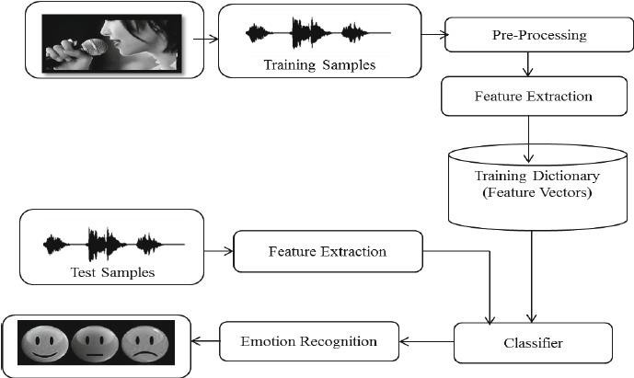
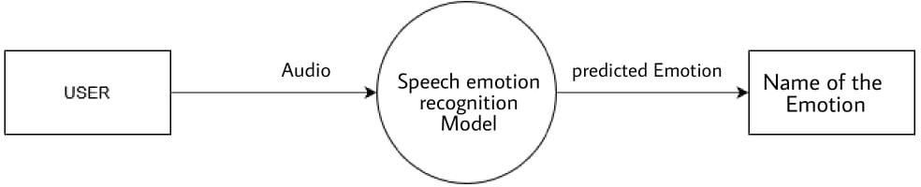
SPEECH EMOTION RECOGNITION USING MLP CLASSIFIER
2021
Chapter 4: System Design
4.1 System Perspective /Architectural Design:
Fig 1.1-Block Diagram
Training data is pre-processed and features are extracted from it. These are used to train SER Model. The model is given with audio inputs and Emotion is recognised from it
4.2 Context Diagram
Fig 2.1-Context Diagram
The user will give Audio as input and the model will predict the emotion and it will be displayed

Slide 21
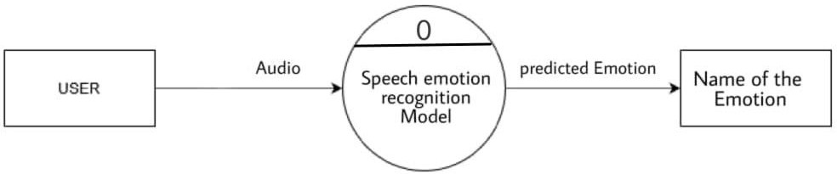
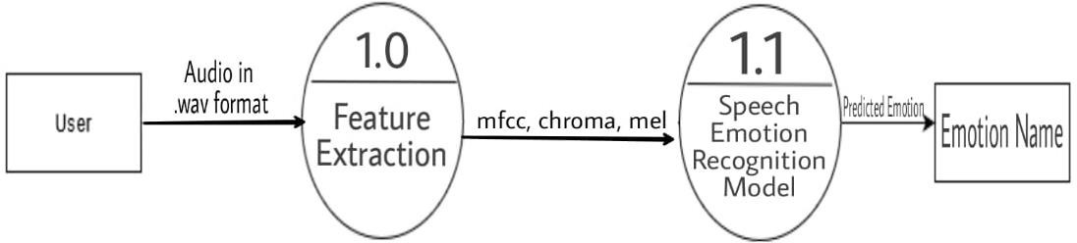
SPEECH EMOTION RECOGNITION USING MLP CLASSIFIER
2021
Chapter 5: Detailed Design
5.1 System Design
Data Flow Diagram:
Level 0
Level 1
Fig 3.1-Data Flow Diagram
The flow of data starts from user by giving audio as a input data and it ends with the output data as predicted emotion

Slide 22
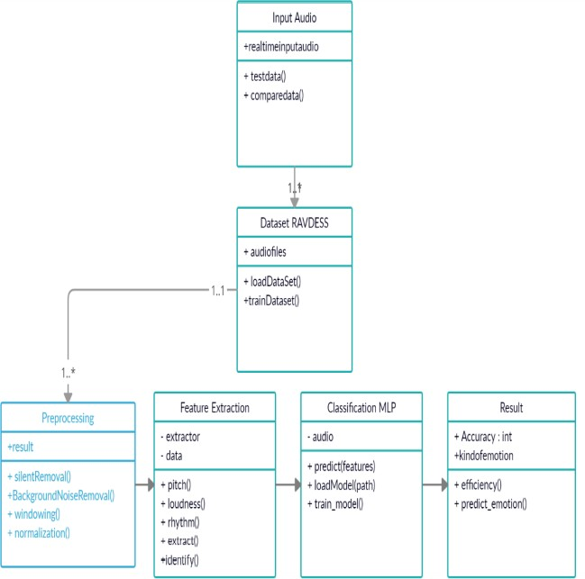
SPEECH EMOTION RECOGNITION USING MLP CLASSIFIER
2021
5.2 Detailed design
Class Diagram:
Fig 4.1: Class Diagram

Slide 23
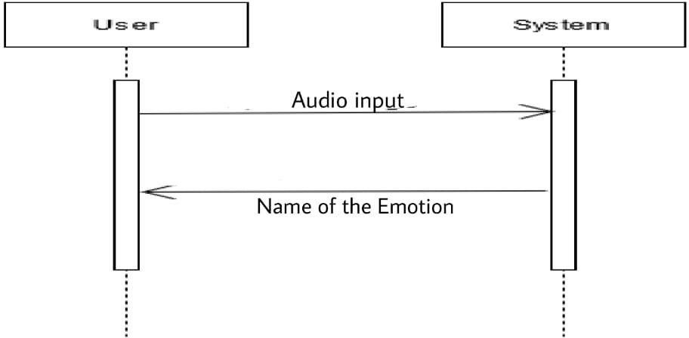
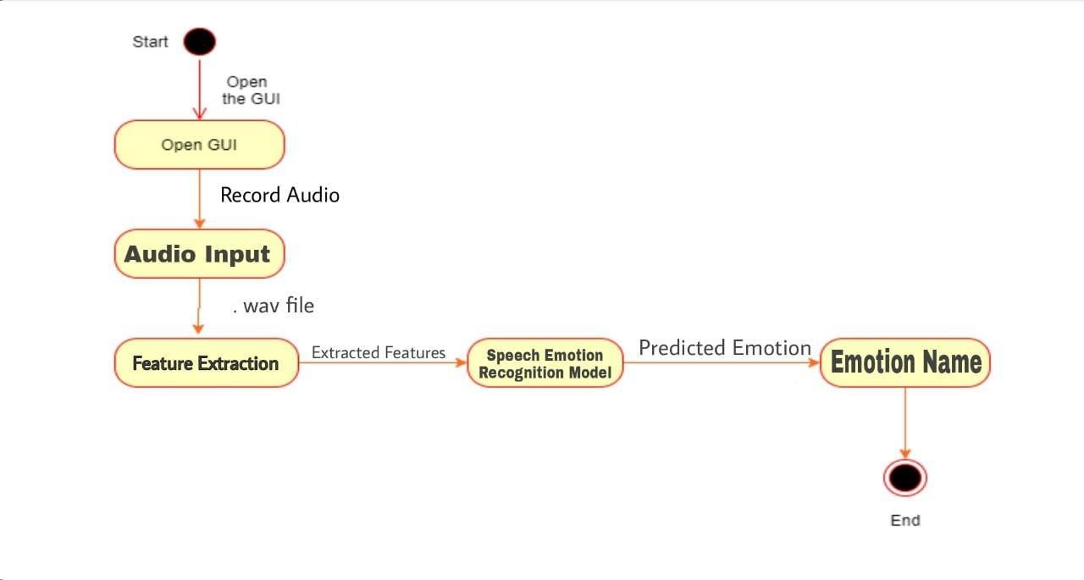
SPEECH EMOTION RECOGNITION USING MLP CLASSIFIER
2021
Sequence Diagram
Fig 5.1-Sequence Diagram
The user will give Audio as input and the model will predict the emotion and it will be displayed
Activity Diagram:
Fig 6.1-Activity Diagram
The User will open GUI and record the audio and give it as input the features will be extracted and will be given as parameters to SER model the model will predict the emotion and display it to user

Slide 24
SPEECH EMOTION RECOGNITION USING MLP CLASSIFIER
2021
Chapter 6 Implementation
6.1 Code Snippets
#INSTALL ALL THE REQUIRED LIBRARIES AND PACKAGES
import os import glob import tqdm
from tqdm.autonotebook import tqdm import pandas as pd
import numpy as np
import matplotlib.pyplot as plt from scipy.io import wavfile
from python_speech_features import mfcc,logfbank import librosa as lr
import os, glob, pickle import librosa
from scipy import signal import noisereduce as nr from glob import glob import librosa
get_ipython().magic('matplotlib inline')
#All the Required Packages and Libraies are installed. import soundfile
from sklearn.utils.class_weight import compute_class_weight from sklearn.model_selection import train_test_split
from sklearn.neural_network import MLPClassifier from sklearn.metrics import accuracy_score print("All the Libraries have been Imported")
# LOADING THE REQUIRED DATASET:-
#Loading the required RAVDESS DataSet with length of 1439 Audio Files

Slide 25
SPEECH EMOTION RECOGNITION USING MLP CLASSIFIER
2021
#os.listdir(path='.\speech-emotion-recognition-ravdess-data')
os.listdir(path='C:\\Users\\Nethra\\Desktop\\Speech_Emotion_Detection-master\\speech-emotion- recognition-ravdess-data')
def getListOfFiles(dirName): listOfFile=os.listdir(dirName)
allFiles=list()
for entry in listOfFile: fullPath=os.path.join(dirName, entry) if os.path.isdir(fullPath):
allFiles=allFiles + getListOfFiles(fullPath) else:
allFiles.append(fullPath) return allFiles
dirName = './speech-emotion-recognition-ravdess-data'
listOfFiles = getListOfFiles(dirName)
# USING SPEECH RECOGNITION API TO CONVERT AUDIO INTO TEXT: -
#Use the Speech-Recognition API to get the Raw Text from Audio Files, Though Speech Recognition #is less strong for large chunk of files , so used Error Handling , where when it is not be able to #produce the text of a particular Audio File it prints the statement 'error'.Just for understanding Audio import speech_recognition as sr
r=sr.Recognizer()
for file in range(0 , len(listOfFiles) , 1):
with sr.AudioFile(listOfFiles[file]) as source: audio = r.listen(source)
try:
text = r.recognize_google(audio) print(text)
except:
print('error')
# PLOTTING TO UNDERSTAND RAW AUDIO FILES: -
#Plotting the Basic Graphs for understanding of Audio Files :

Slide 26
SPEECH EMOTION RECOGNITION USING MLP CLASSIFIER
2021
for file in range(0 , len(listOfFiles) , 1):
audio , sfreq = lr.load(listOfFiles[file]) time = np.arange(0 , len(audio)) / sfrez fig ,ax = plt.subplots()
ax.plot(time , audio)
ax.set(xlabel = 'Time (s)' , ylabel = 'Sound Amplitude') plt.show()
#PLOT THE SEPCTOGRAM
for file in range(0 , len(listOfFiles) , 1):
sample_rate , samples = wavfile.read(listOfFiles[file])
frequencies , times, spectrogram = signal.spectrogram(samples, sample_rate) plt.pcolormesh(times, frequencies, spectrogram)
plt.imshow(spectrogram) plt.ylabel('Frequency [Hz]') plt.xlabel('Time [sec]') plt.show()
# VISUALISATION OF AUDIO DATA:-
#Next Step is In-Depth Visualisation of Audio Fiels and its certain features to plot for. #They are the Plotting Functions to be called later.
def plot_signals(signals):
fig , axes = plt.subplots(nrows=2, ncols=5,sharex =False , sharey=True, figsize=(20,5)) fig.suptitle('Time Series' , size=16)
for x in range(2): for y in range(5):
axes[x,y].set_title(list(signals.keys())[i]) axes[x,y].plot(list(signals.values())[i]) axes[x,y].get_xaxis().set_visible(False) axes[x,y].get_yaxis().set_visible(False) i +=1
def plot_fft(fft):
fig , axes = plt.subplots(nrows=2, ncols=5,sharex =False , sharey=True, figsize=(20,5))

Slide 27
SPEECH EMOTION RECOGNITION USING MLP CLASSIFIER
2021
fig.suptitle('Fourier Transform' , size=16)
i=0
for x in range(2): for y in range(5):
data = list(fft.values())[i] Y,freq = data[0] , data[1]
axes[x,y].set_title(list(fft.keys())[i]) axes[x,y].plot(freq , Y) axes[x,y].get_xaxis().set_visible(False) axes[x,y].get_yaxis().set_visible(False) i +=1
def plot_fbank(fbank):
fig , axes = plt.subplots(nrows=2, ncols=5,sharex =False , sharey=True, figsize=(20,5)) fig.suptitle('Filter Bank Coefficients' , size=16)
i=0
for x in range(2): for y in range(5):
axes[x,y].set_title(list(fbank.keys())[i]) axes[x,y].imshow(list(fbank.values())[i],cmap='hot', interpolation = 'nearest') axes[x,y].get_xaxis().set_visible(False) axes[x,y].get_yaxis().set_visible(False)
i +=1
def plot_mfccs(mfccs):
fig , axes = plt.subplots(nrows=2, ncols=5,sharex =False , sharey=True, figsize=(20,5)) fig.suptitle('Mel Frequency Capstrum Coefficients' , size=16)
i=0
for x in range(2): for y in range(5):
axes[x,y].set_title(list(mfccs.keys())[i])
axes[x,y].imshow(list(mfccs.values())[i],

Slide 28
SPEECH EMOTION RECOGNITION USING MLP CLASSIFIER
2021
cmap='hot', interpolation = 'nearest')
axes[x,y].get_xaxis().set_visible(False) axes[x,y].get_yaxis().set_visible(False) i +=1
def calc_fft(y,rate): n = len(y)
freq = np.fft.rfftfreq(n , d= 1/rate) Y= abs(np.fft.rfft(y)/n) return(Y,freq)
# HERE THE DATA SET IS LOADED AND PLOTS ARE VISUALISED BY CALLING THE PLOTTING FUNCTIONS .
import matplotlib.pyplot as plt
from scipy.io import wavfile as wav from scipy.fftpack import fft
import numpy as np
for file in range(0 , len(listOfFiles) , 1): rate, data = wav.read(listOfFiles[file]) fft_out = fft(data)
get_ipython().run_line_magic('matplotlib', 'inline') plt.plot(data, np.abs(fft_out))
plt.show() signals={} fft={} fbank={} mfccs={}
# load data
for file in range(0 , len(listOfFiles) , 1):
# rate, data = wavfile.read(listOfFiles[file]) signal,rate =librosa.load(listOfFiles[file] , sr=44100) mask = envelope(signal , rate , 0.0005)

Slide 29
SPEECH EMOTION RECOGNITION USING MLP CLASSIFIER
2021
signals[file] = signal
fft[file] = calc_fft(signal , rate)
bank = logfbank(signal[:rate] , rate , nfilt = 26, nfft = 1103).T fbank[file] = bank
mel = mfcc(signal[:rate] , rate , numcep =13 , nfilt = 26 , nfft=1103).T mfccs[file]=mel
plot_signals(signals) plt.show() plot_fft(fft) plt.show() plot_fbank(fbank) plt.show() plot_mfccs(mfccs) plt.show() print("over")
#CLEANING AND MASKING:-
#Now Cleaning Step is Performed where:
#DOWN SAMPLING OF AUDIO FILES IS DONE AND PUT MASK OVER IT AND DIRECT INTO CLEAN FOLDER
#MASK IS TO REMOVE UNNECESSARY EMPTY VOIVES AROUND THE MAIN AUDIO VOICE
def envelope(y , rate, threshold): mask=[] y=pd.Series(y).apply(np.abs)
y_mean = y.rolling(window=int(rate/10) , min_periods=1 , center = True).mean() for mean in y_mean:
if mean>threshold:
mask.append(True) else:
mask.append(False) return mask
print("Finished Executing")

Slide 30
SPEECH EMOTION RECOGNITION USING MLP CLASSIFIER
2021
#The clean Audio Files are redirected to Clean Audio Folder Directory
import glob,pickle
for file in tqdm(glob.glob('C:/Users/Nethra/Desktop/Speech_Emotion_Detection-master/speech- emotion-recognition-ravdess-data//**//**.wav')):
file_name = os.path.basename(file) signal , rate = librosa.load(file, sr=16000) mask = envelope(signal,rate, 0.0005)
wavfile.write(filename= 'C:/Users/Nethra/Desktop/Speech_Emotion_Detection- master//clean//'+str(file_name), rate=rate,data=signal[mask])
# FEATURE EXTRACTION
#Feature Extraction of Audio Files Function
#Extract features (mfcc, chroma, mel) from a sound file def extract_feature(file_name, mfcc, chroma, mel):
with soundfile.SoundFile(file_name) as sound_file: X = sound_file.read(dtype="float32") sample_rate=sound_file.samplerate
if chroma: stft=np.abs(librosa.stft(X))
result=np.array([])
if mfcc:
mfccs=np.mean(librosa.feature.mfcc(y=X, sr=sample_rate, n_mfcc=40).T, axis=0) result=np.hstack((result, mfccs))
if chroma:
chroma=np.mean(librosa.feature.chroma_stft(S=stft, sr=sample_rate).T,axis=0) result=np.hstack((result, chroma))
if mel:
mel=np.mean(librosa.feature.melspectrogram(X, sr=sample_rate).T,axis=0) result=np.hstack((result, mel))
return result
# LABELS CLASSIFICATION
#Emotions in the RAVDESS dataset to be classified Audio Files based on .

Slide 31
SPEECH EMOTION RECOGNITION USING MLP CLASSIFIER
2021
emotions={
'01':'neutral',
'02':'calm',
'03':'happy',
'04':'sad',
'05':'angry',
'06':'fearful',
'07':'disgust',
'08':'surprised'
}
#These are the emotions User wants to observe more :
observed_emotions=['calm', 'happy', 'fearful', 'disgust','neutral','sad','angry','surprised'] print("Executed this block")
# LOADING OF DATA AND SPLITTING OF DATASET
# (TRAINING AND TESTING DATA)
#Load the data and extract features for each sound file from glob import glob
import os import glob
def load_data(test_size=0.33): x,y=[],[]
answer = 0
for file in glob.glob('C:/Users/Nethra/Desktop//Speech_Emotion_Detection-master/clean//*.wav'): file_name=os.path.basename(file)
emotion=emotions[file_name.split("-")[2]] if emotion not in observed_emotions:
answer += 1 continue
feature=extract_feature(file, mfcc=True, chroma=True, mel=True) x.append(feature)
y.append([emotion,file_name])

Slide 32
SPEECH EMOTION RECOGNITION USING MLP CLASSIFIER
2021
return train_test_split(np.array(x), y, test_size=test_size, random_state=9)
print("Loading the data and extract features for each sound file")
# MAPPING OF TESTING DATA TO THEIR CORRESPONDING FILENAMES AS LABELS
#Split the dataset import librosa import numpy as np
x_train,x_test,y_trai,y_tes=load_data(test_size=0.30)
print(np.shape(x_train),np.shape(x_test), np.shape(y_trai),np.shape(y_tes)) y_test_map = np.array(y_tes).T
y_test = y_test_map[0] test_filename = y_test_map[1] y_train_map = np.array(y_trai).T
y_train = y_train_map[0] train_filename = y_train_map[1]
#print(np.shape(y_train),np.shape(y_test))
print(*test_filename,sep="\n")
#Get the shape of the training and testing datasets # print((x_train.shape[0], x_test.shape[0])) print((x_train[0], x_test[0]))
#Get the number of features extracted
print(f'Features extracted: {x_train.shape[1]}')
# APPLYING THE MLP CLASSIFIER
# Initialize the Multi Layer Perceptron Classifier
model=MLPClassifier(alpha=0.01, batch_size=256, epsilon=1e-08, hidden_layer_sizes=(300,), learning_rate='adaptive', max_iter=500)
#Train the model
model.fit(x_train,y_train)

Slide 33
SPEECH EMOTION RECOGNITION USING MLP CLASSIFIER
2021
#SAVING THE MODEL
import pickle
# Save the Modle to file in the current working directory #For any new testing data other than the data in dataset Pkl_Filename = "Emotion_Voice_Detection_Model.pkl" with open(Pkl_Filename, 'wb') as file:
pickle.dump(model, file)
# Load the Model back from file
with open(Pkl_Filename, 'rb') as file: Emotion_Voice_Detection_Model = pickle.load(file)
Emotion_Voice_Detection_Model Pkl_Filename = "Pickle_sorted_Model.pkl"
# PREDICT THE TEST DATA USING THE SAVED MODEL
#predicting : y_pred=Emotion_Voice_Detection_Model.predict(x_test) y_pred
# STORE THE PREDICTED FILE IN .CSV FILE
#Store the Prediction probabilities into CSV file import numpy as np
import pandas as pd
y_pred1 = pd.DataFrame(y_pred, columns=['predictions']) y_pred1['file_names'] = test_filename
print(y_pred1)
y_pred1.to_csv('predictionfinal.csv')
# REAL TIME IMPLEMENATION
data, sampling_rate = librosa.load('audio.wav')

Slide 34
SPEECH EMOTION RECOGNITION USING MLP CLASSIFIER
2021
get_ipython().run_line_magic('matplotlib', 'inline')
import os
import pandas as pd import librosa.display import glob plt.figure(figsize=(15, 5))
librosa.display.waveplot(data, sr=sampling_rate) audiofile = 'audio.wav'
# data , sr = librosa.load(file) # data = np.array(data)
feature=extract_feature(audiofile, mfcc=True, chroma=True, mel=True) #print(feature)
ans = np.array(feature)
print("Emotion in this speech is ",Emotion_Voice_Detection_Model.predict([ans]))
# STORE IN DATABASE
import pymysql
con=pymysql.connect (host="localhost", user="root",passwd="1234",db="speech") print("Database Successfully connected") a=Emotion_Voice_Detection_Model.predict([ans])
class mydb:
def insert(self,audio,output): self.audio=audio self.output=output cur=con.cursor()
cur.execute(''' insert into store3(audioname,output)values('%s','%s')'''%(audio,output)) con.commit()
print("inserted") obj=mydb() audio=audiofile output=a[0]
print("The emotion detected from the speech is:",output)

Slide 35
SPEECH EMOTION RECOGNITION USING MLP CLASSIFIER
2021
print(audio)
obj.insert(audio,output)
#Confusion Matrix
from sklearn.metrics import confusion_matrix import matplotlib.pyplot as plt
from sklearn.metrics import plot_confusion_matrix #tn, fp, fn, tp =confusion_matrix(y_test, y_pred).ravel() fig, ax = plt.subplots(figsize=(10, 10))
plot_confusion_matrix(Emotion_Voice_Detection_Model, x_test, y_test,ax=ax)

Slide 36
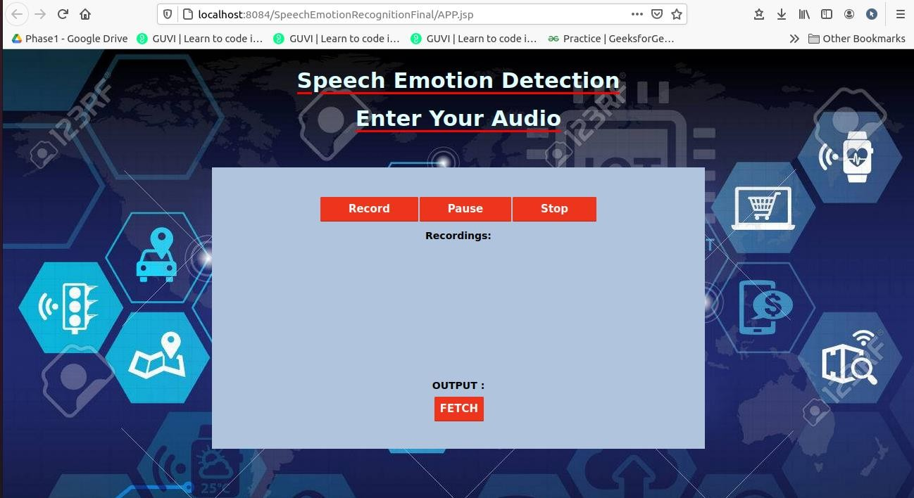
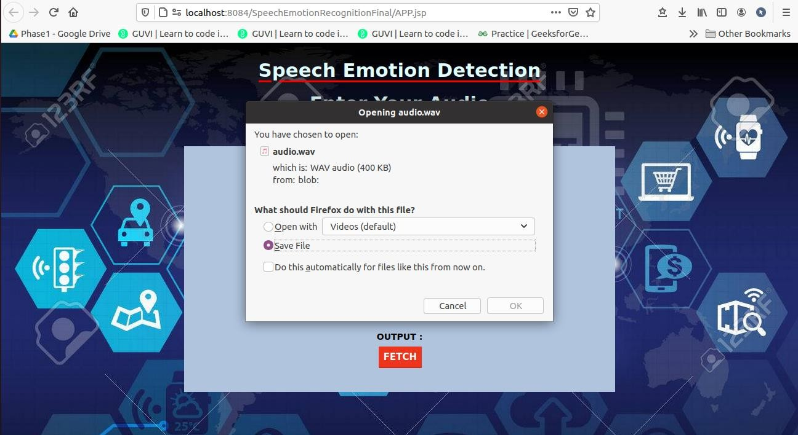
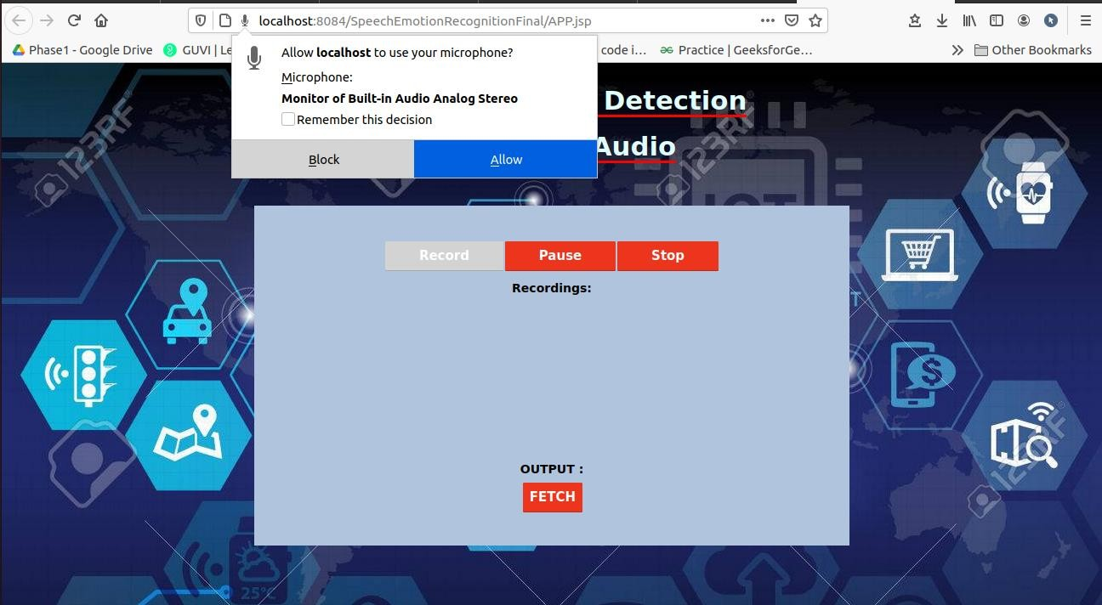
SPEECH EMOTION RECOGNITION USING MLP CLASSIFIER
2021
6.2 Implementation
Screenshot 1: The GUI page of the SER Project
Screenshot 2: The user will be asked for permission

Slide 37
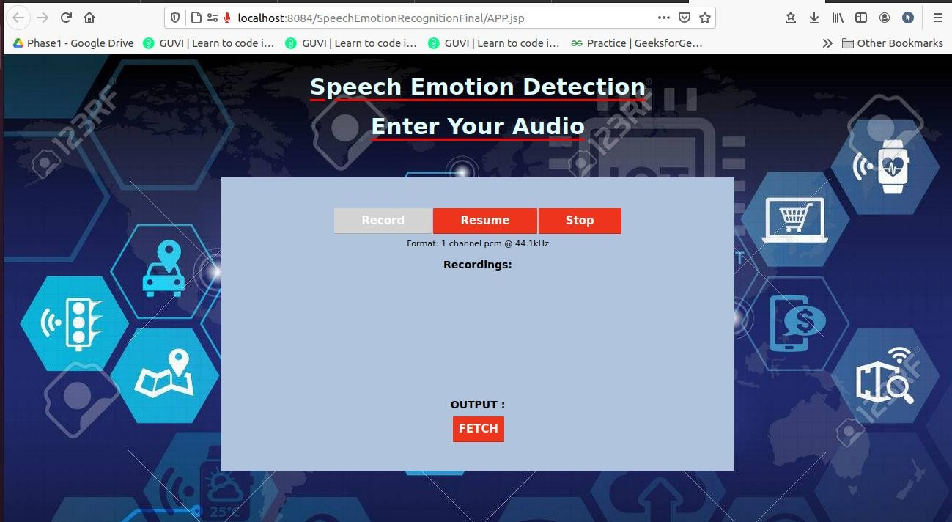
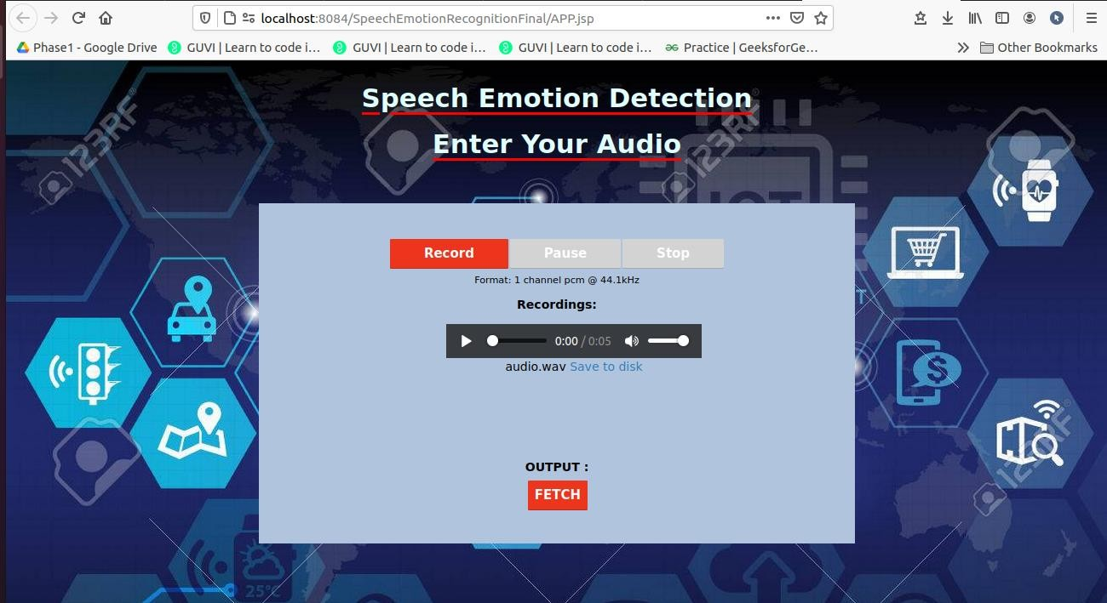
SPEECH EMOTION RECOGNITION USING MLP CLASSIFIER
2021
Screenshot 3: The Audio is being recorded
Screenshot 4: Recorded audio will be displayed

Slide 38
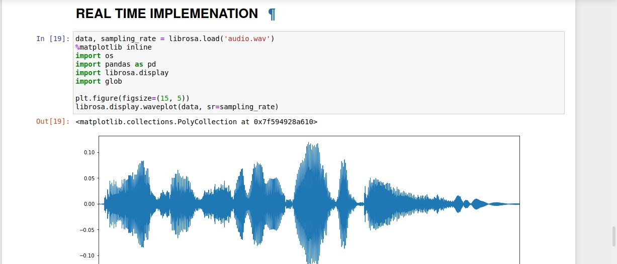
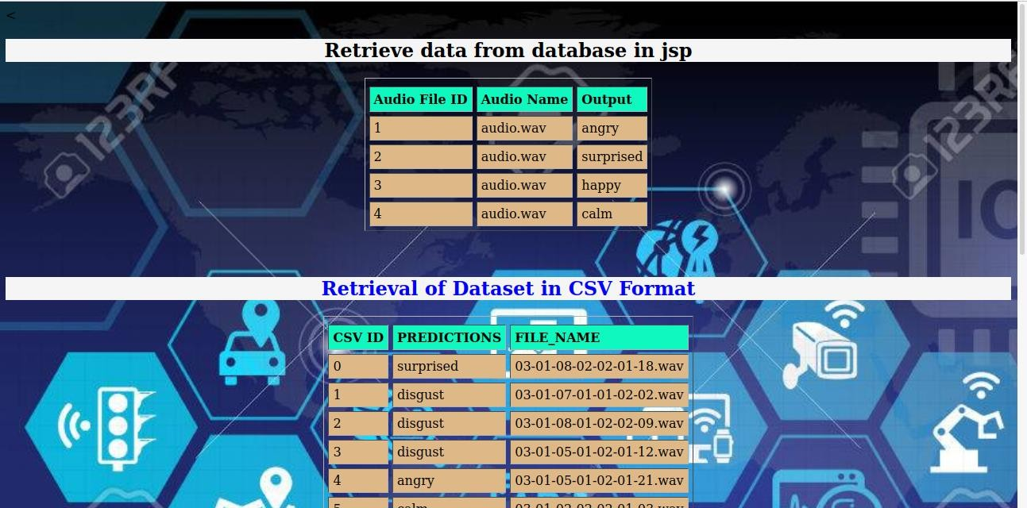
SPEECH EMOTION RECOGNITION USING MLP CLASSIFIER
2021
Screenshot 5: Plotting of Recorded Audio
Screenshot 6: Emotion Displayed on GUI

Slide 39
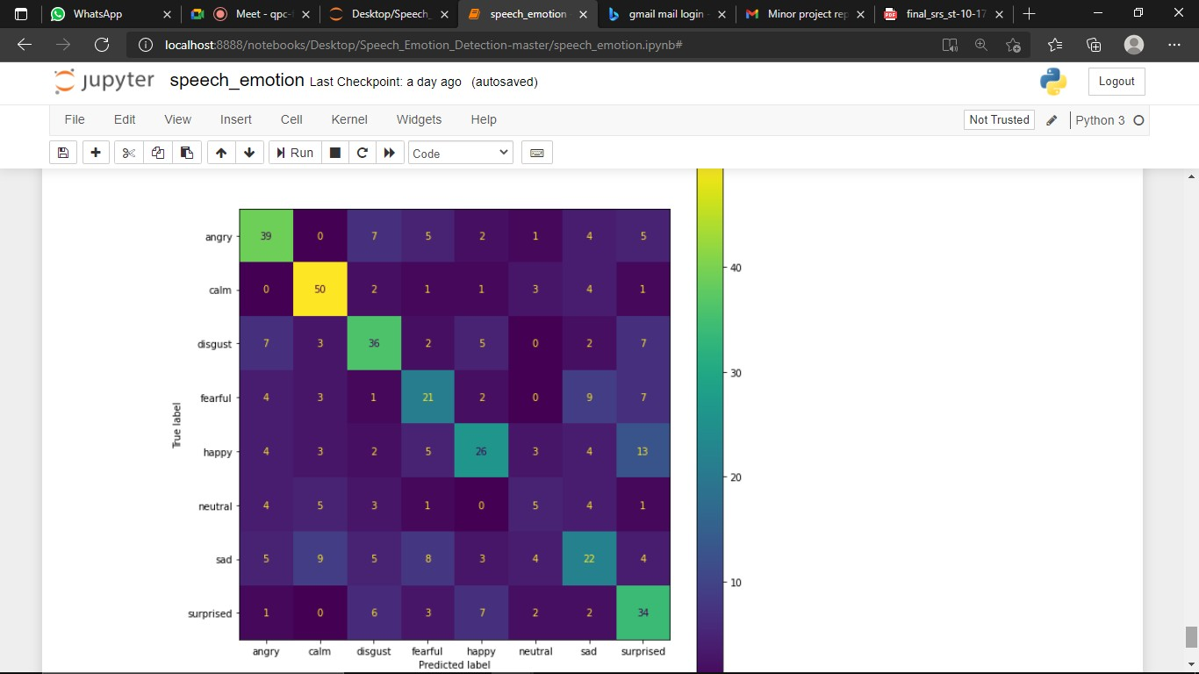
SPEECH EMOTION RECOGNITION USING MLP CLASSIFIER
2021
Screenshot 7: Confusion matrix of the SER model

Slide 40
SPEECH EMOTION RECOGNITION USING MLP CLASSIFIER
2021
Chapter 7: Software Testing
7.1 Test cases
White Box Testing: Here we are testing internal operations of system, it involves testing of software code forflow of specific inputs through the code.
Unit Testing: Here individual units or components of software are tested the purpose is to validate that each unit of software code performs as expected .It is done in developmentphase of an application by developers.
Integration Testing: Here individual units or components of the application’s source codes are combined and tested as a group. The purpose is to expose errors in the interactions of different interfaces with one another. It is done after unit testing.

Slide 41
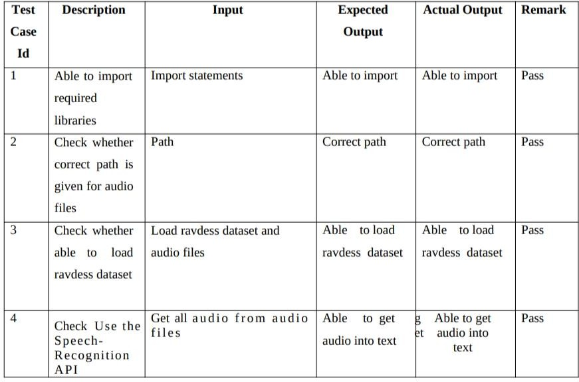
SPEECH EMOTION RECOGNITION USING MLP CLASSIFIER
2021
7.2 Test cases and Validation

Slide 42
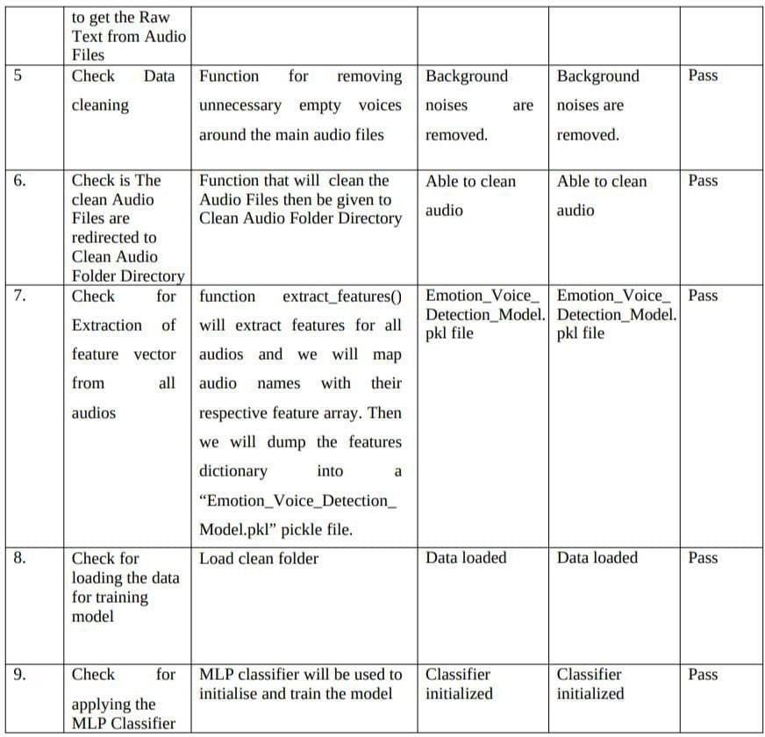
SPEECH EMOTION RECOGNITION USING MLP CLASSIFIER
2021

Slide 43
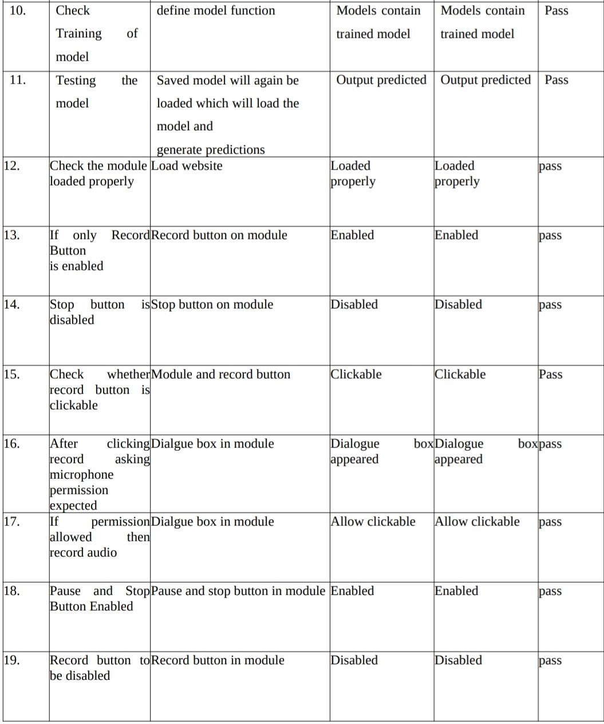
SPEECH EMOTION RECOGNITION USING MLP CLASSIFIER
2021

Slide 44
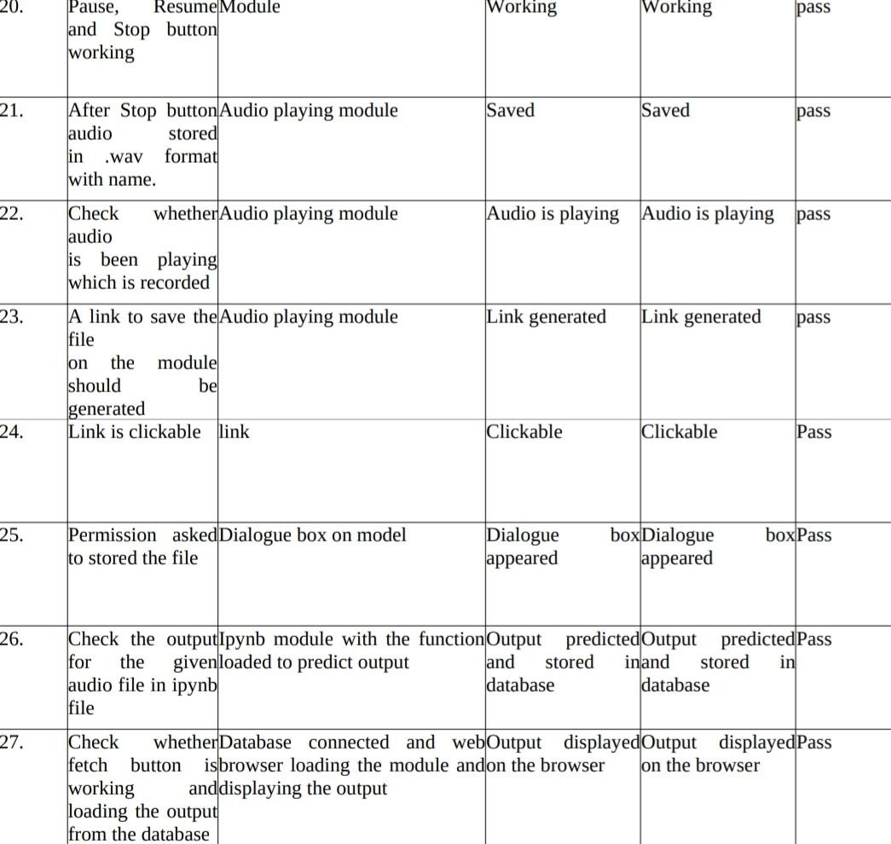
SPEECH EMOTION RECOGNITION USING MLP CLASSIFIER
2021

Slide 45
SPEECH EMOTION RECOGNITION USING MLP CLASSIFIER
2021
28 | Loading the required libraries | Import <library name> | Imported successfully | No library found | Fail
29 | Loading the Dataset | Ravdees dataset | Dataset loaded | Dataset not found | Fail
30 | Cleaning the dataset | Ravdees dataset | Cleaned successfully | Something went wrong | Fail
31 | Checking for permission | web page | Permission granted | Permission denied | Fail
32 | Writing to csv file | Csv file | Successful | Permission denied | Fail

Slide 46
SPEECH EMOTION RECOGNITION USING MLP CLASSIFIER
2021
Chapter 8: Conclusion
It can be used in virtual assistants such as google assistant, Siri, Alexa etc. Machine can also understand the emotion of the human and can respond in corresponding way. Speech emotion model is improving the human computer interaction. The proposed model achieved an accuracy of 80.67%. Calm was the best identified emotion. The model gets confused between similar emotions like calm-neutral, happy-surprised. The model was tested using many test cases. The failed test cases were corrected. The system could take into consideration multiple speakers from different geographic locations speaking with different accents. Though standard feed forward MLP is powerful tool for classification problems. Study shows that people suffering with autism have difficulty expressing their emotions explicitly. Image based speech processing in real time can prove to be of great assistance.
Chapter 9: Future Enhancements

Slide 47
SPEECH EMOTION RECOGNITION USING MLP CLASSIFIER
2021
Some of the drawbacks can be resolved in the future to make the model more accurate and efficient.
The model can be improved by training the model a variety of datasets which increases the accuracy of the model.
Removing the disturbance from the input audio which deviates from correct prediction.
Adding more emotions to the system since this system can identify only 8 emotions. Extracting more features from the speech to improve the classification process
Bibliography

Slide 48
SPEECH EMOTION RECOGNITION USING MLP CLASSIFIER
2021
Proceedings of the International Conference on Smart Electronics and Communication (ICOSEC 2020) IEEE Xplore Part Number: CFP20V90-ART; ISBN: 978-1-7281-5461-9
2017 4th International Conference on Signal Processing and Integrated Networks (SPIN)
Proceedings of the Third International Conference on Computing Methodologies and Communication (ICCMC 2019) IEEE Xplore Part Number: CFP19K25-ART; ISBN: 978-1- 5386-7808-4
International Conference on Inventive Communication and Computational Technologies (ICICCT 2017)
Proc. of the 2017 IEEE Region 10 Conference (TENCON), Malaysia, November 5-8, 2017
2015 International Conference on Affective Computing and Intelligent Interaction (ACII)
Received July 25, 2019, accepted August 5, 2019, date of publication August 19, 2019, date of current version September 4, 2019
Received May 10, 2019, accepted June 2, 2019, date of publication June 6, 2019, date of current version June 24, 2019
Mustaqeem et al.: Clustering-Based SER by Incorporating Learned Features and IEEE Access, vol. 6, pp. 52227–52237, 2018.
International Journal of Applied Engineering Research ISSN 0973-4562 Volume 12, Number 16 (2017) pp. 5760-5767

